Slide 1

Assignment 7 – File Shares
Daphne Camodoc

Slide 2
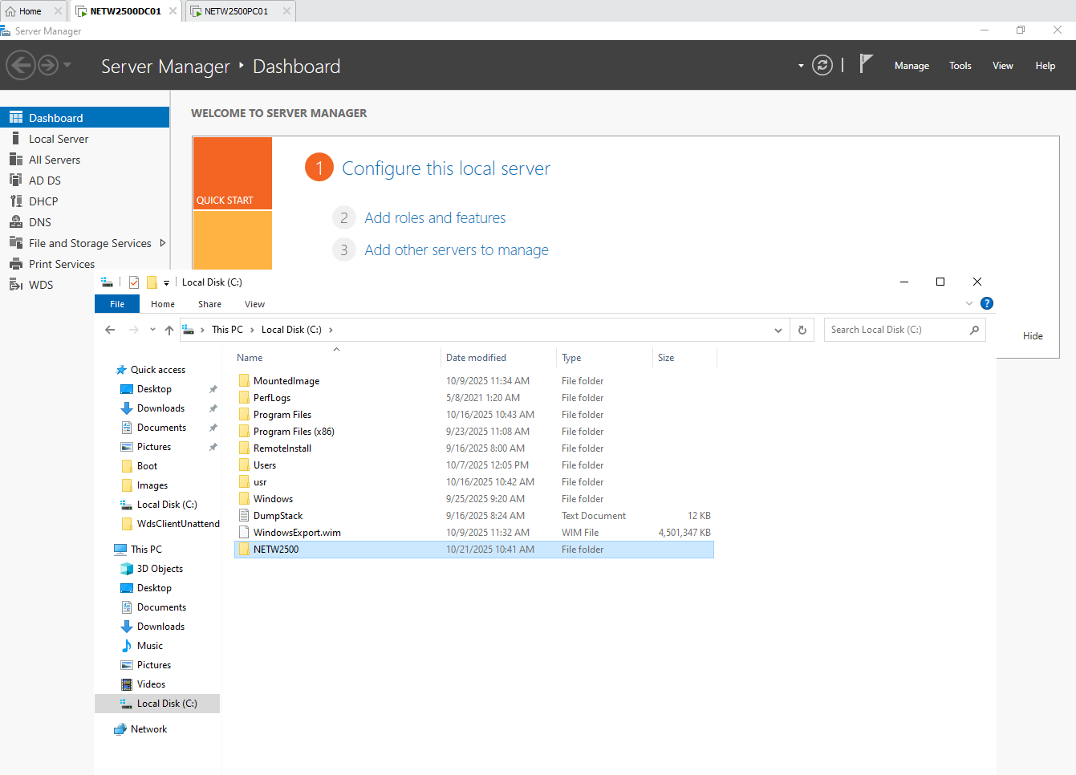
Create a File Folder "NETW2500" in your C: drive on your windows server

Slide 3
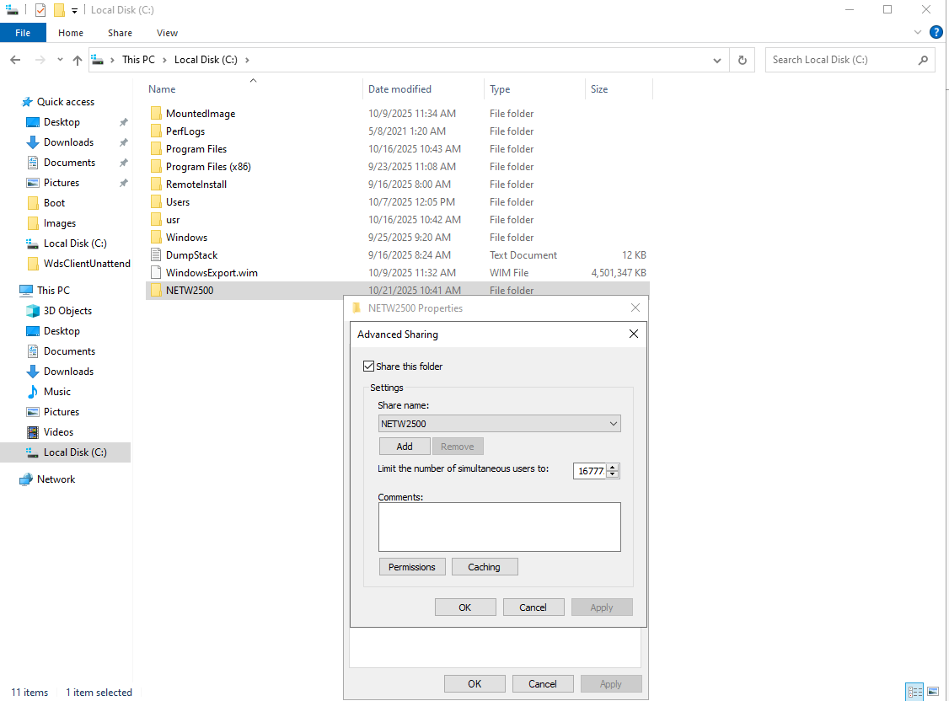
Create a file share from this folder using advanced sharing named "NETW2500"

Slide 4
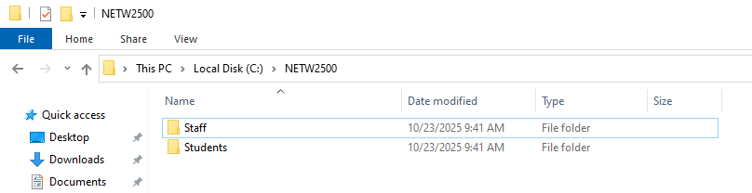
Create subfolders within the share: Staff, Students

Slide 5
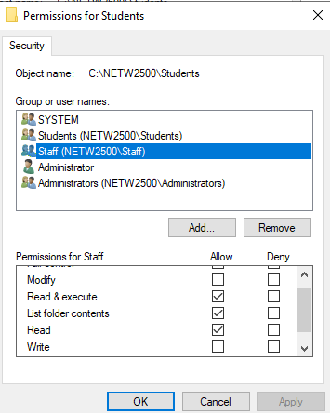
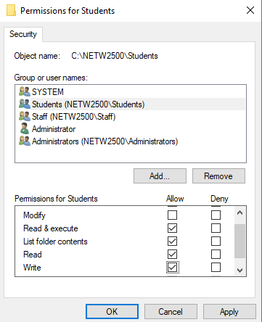
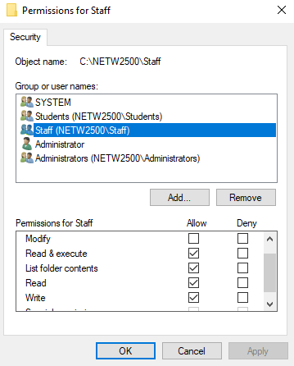
Techs will have full control of all folders Staff folder: staff should be able to view and write Students folder: students should be able to view and write, staff should be able to view

Slide 6
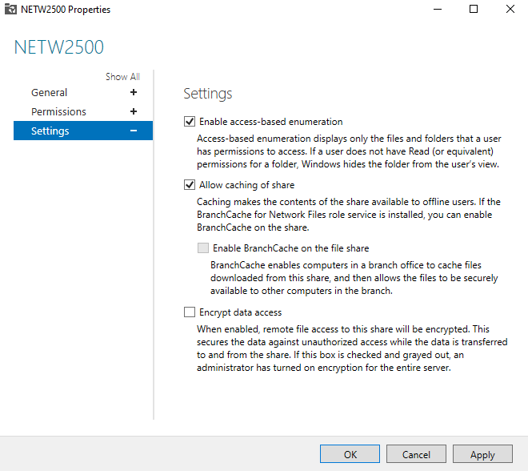
Users should not see the folders appear that they do not have access to, even if permission doesn't allow them to enter the folder

Slide 7
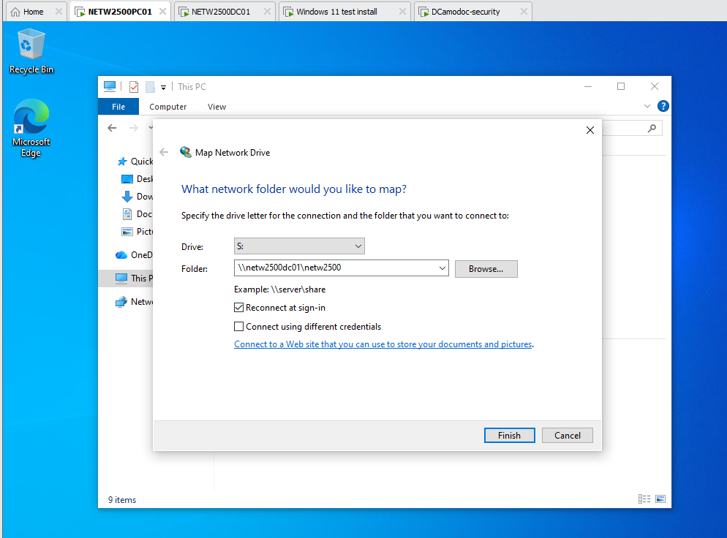
Manually map the drive using file explorer to s:

Slide 8
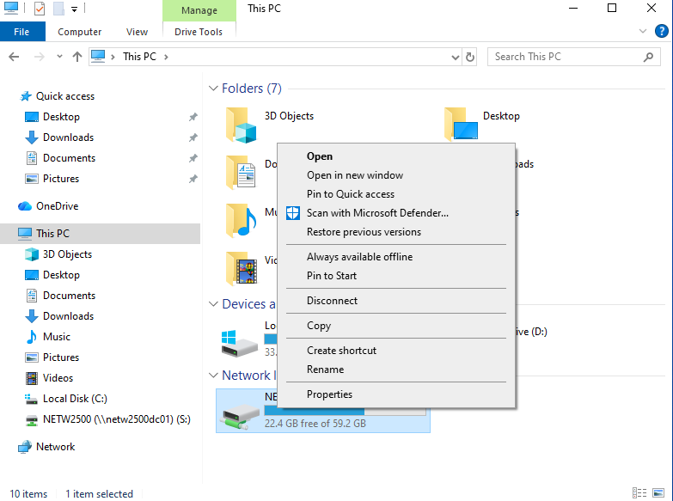
Disconnect drives using file explorer

Slide 9
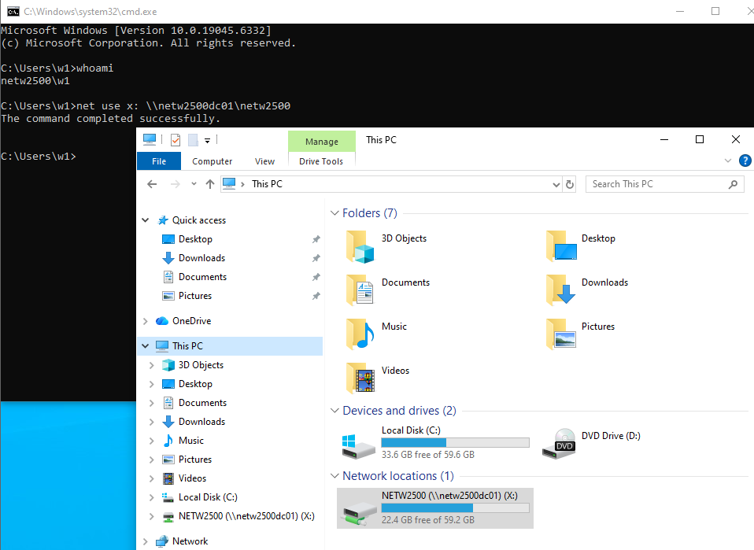
Map drive to x: using command line

Slide 10
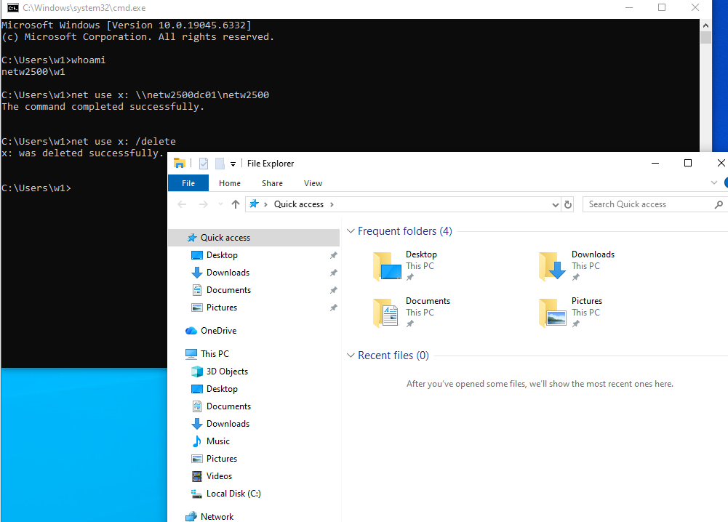
Disconnect drive using command line

Slide 11
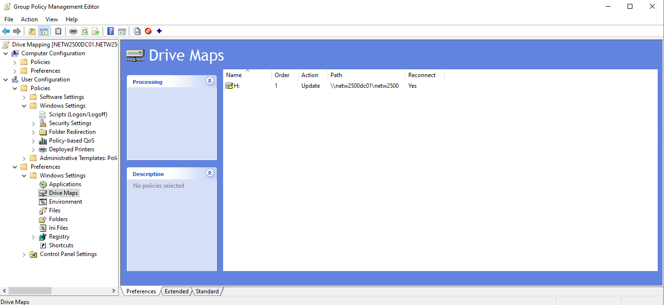
Deploy gpo to user ou to map drives for all users

Slide 12
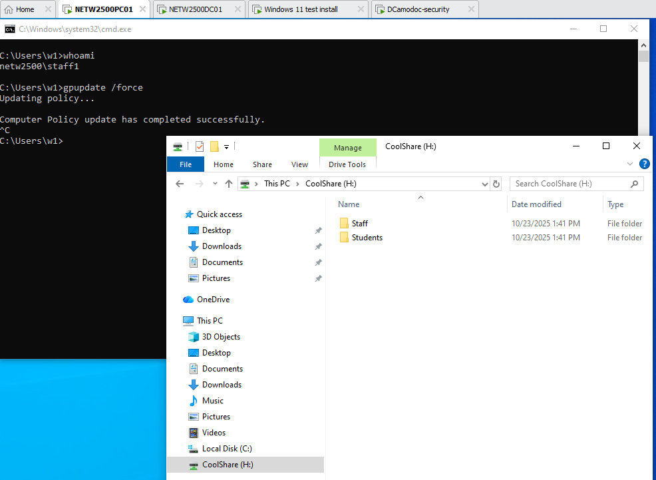
Login as staff showing drive has been mapped and access to both folders

Slide 13
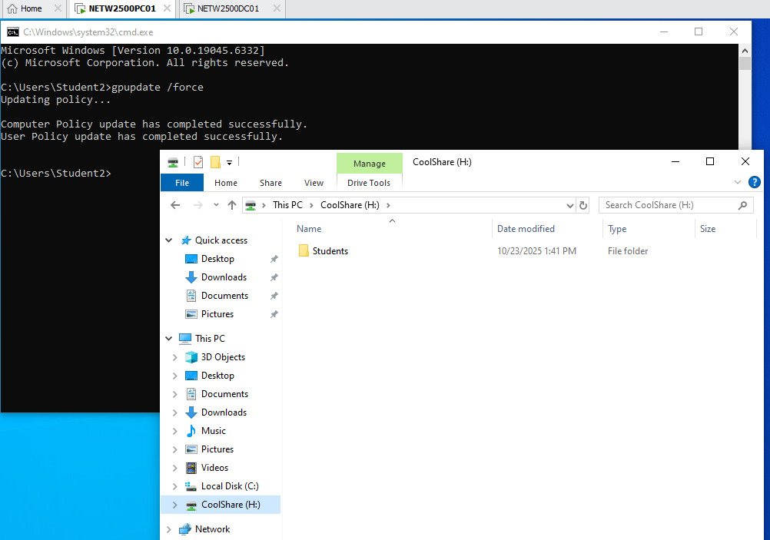
Login as student show drive has been mapped and access to student folder and cannot see staff folder

